Slide 1
Seller/Service Provider Registration-Using Aadhaar
Designed by GeM Training Team

Slide 2
Open www.gem.gov.in
Designed by GeM Training Team

Slide 4
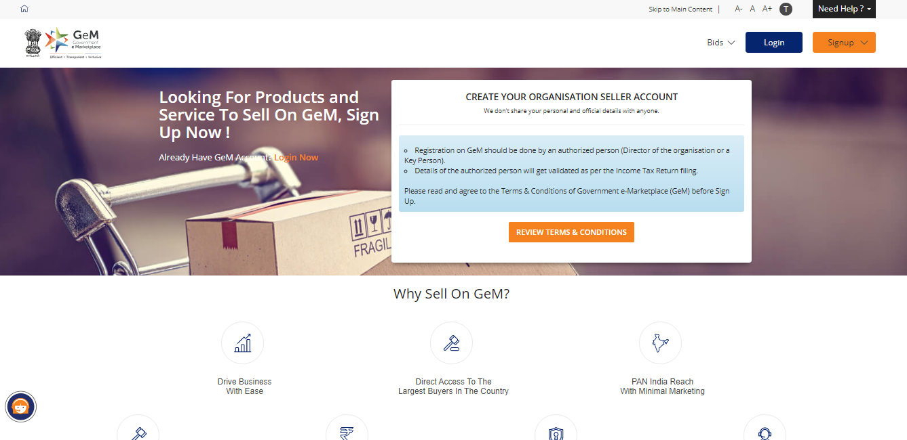

Slide 6
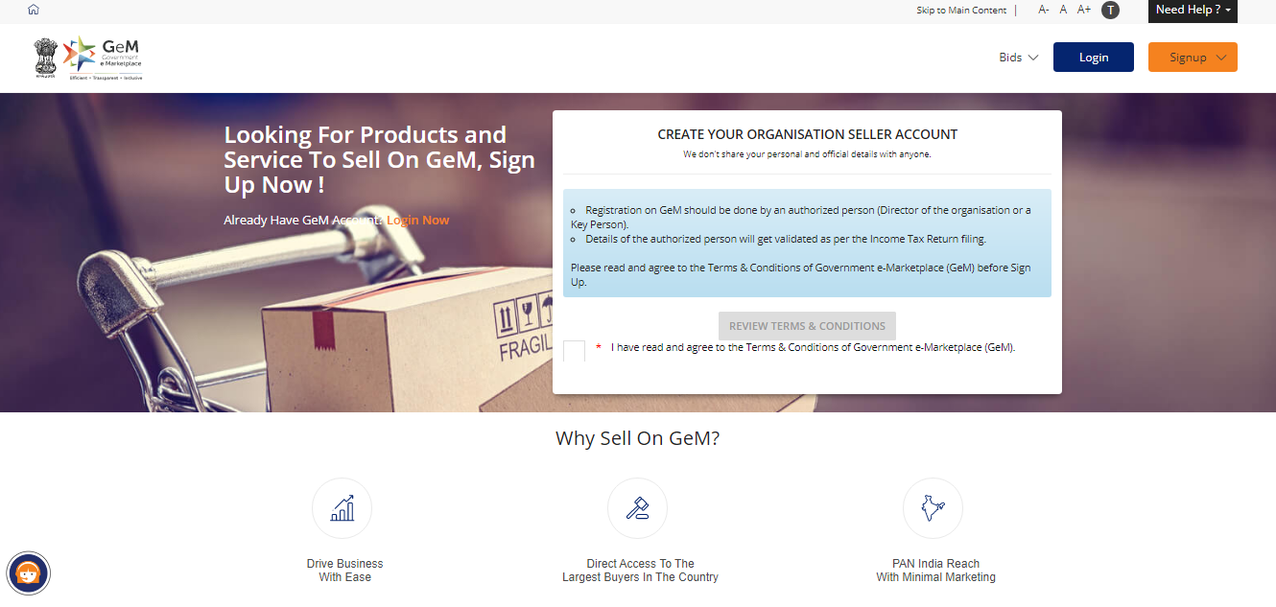

Slide 7
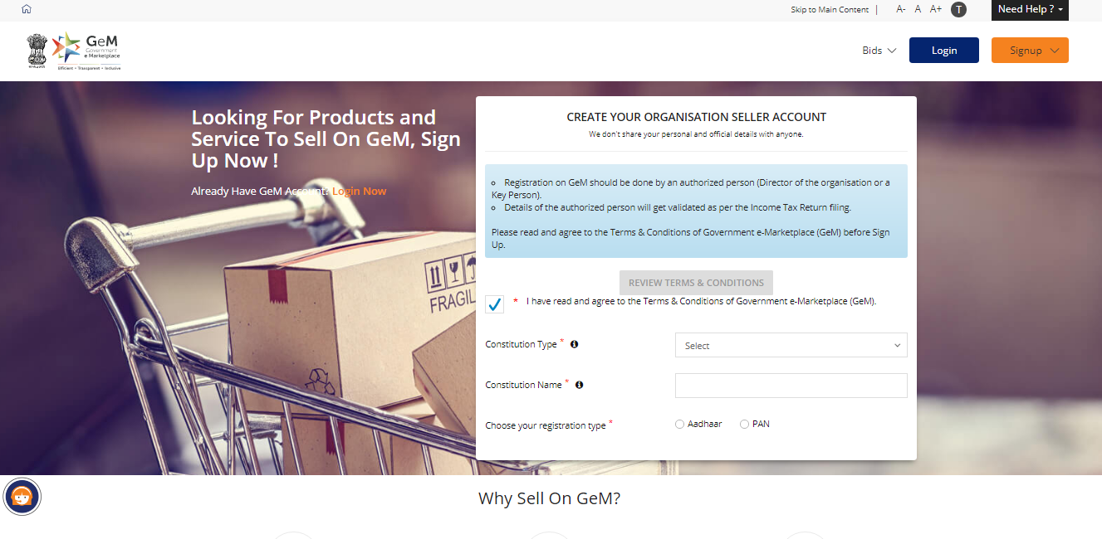
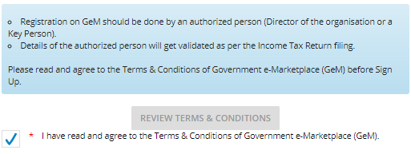

Slide 8
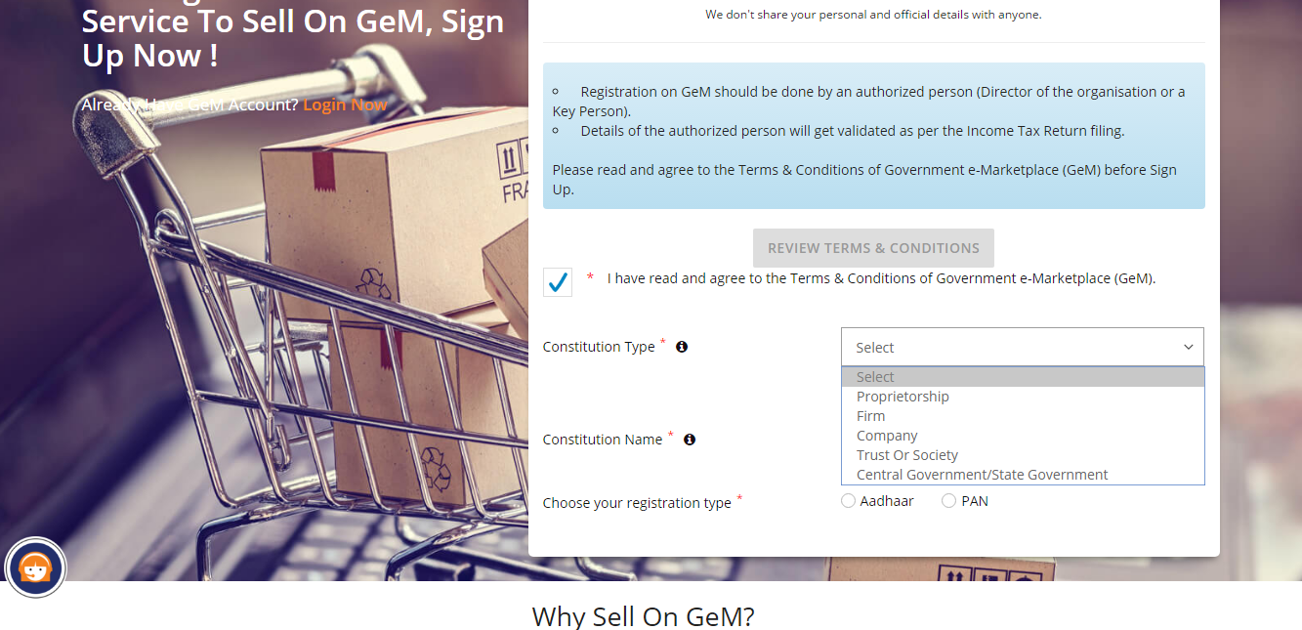

Slide 9
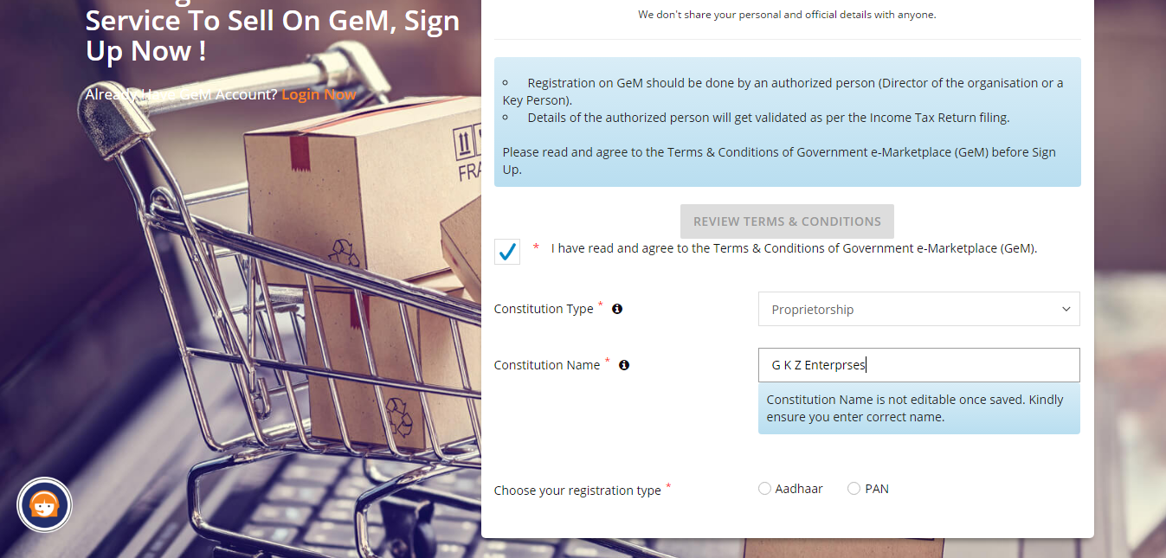

Slide 10
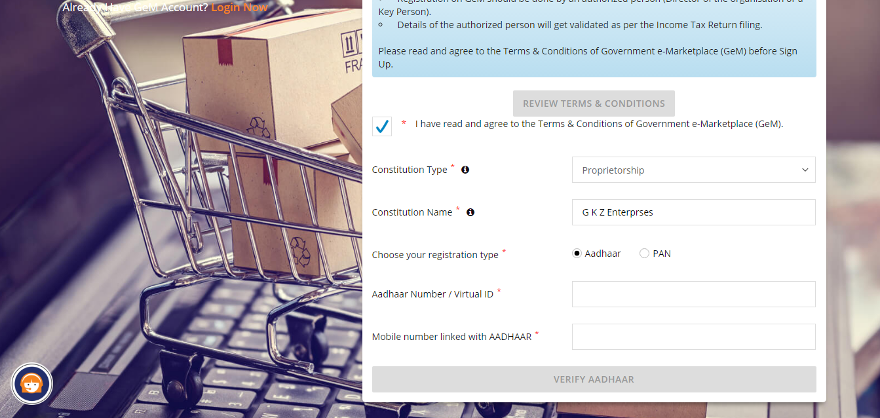

Slide 12
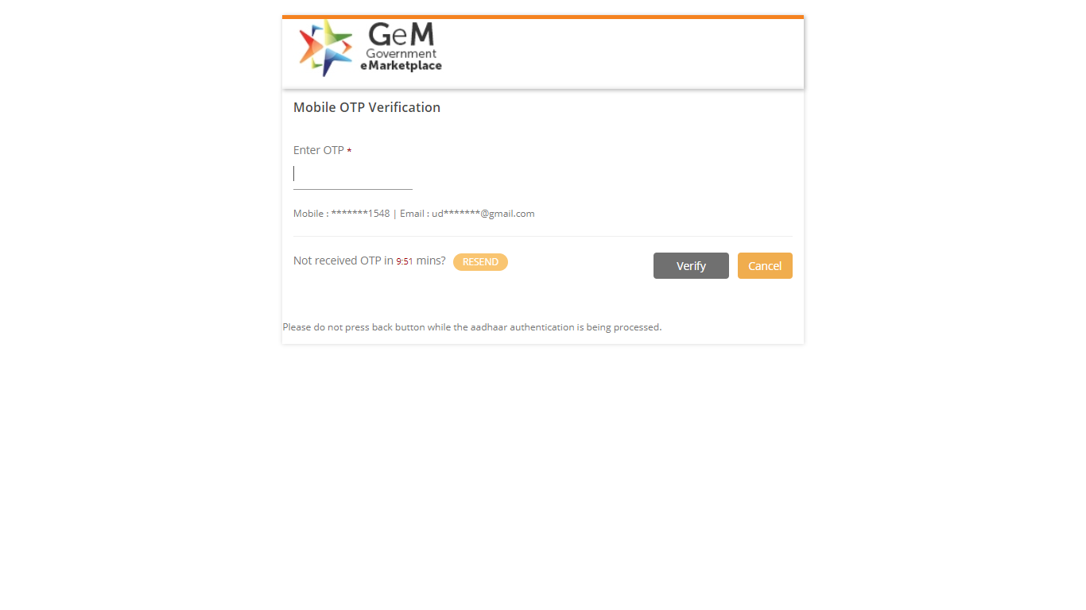
Designed by GeM Training Team

Slide 13
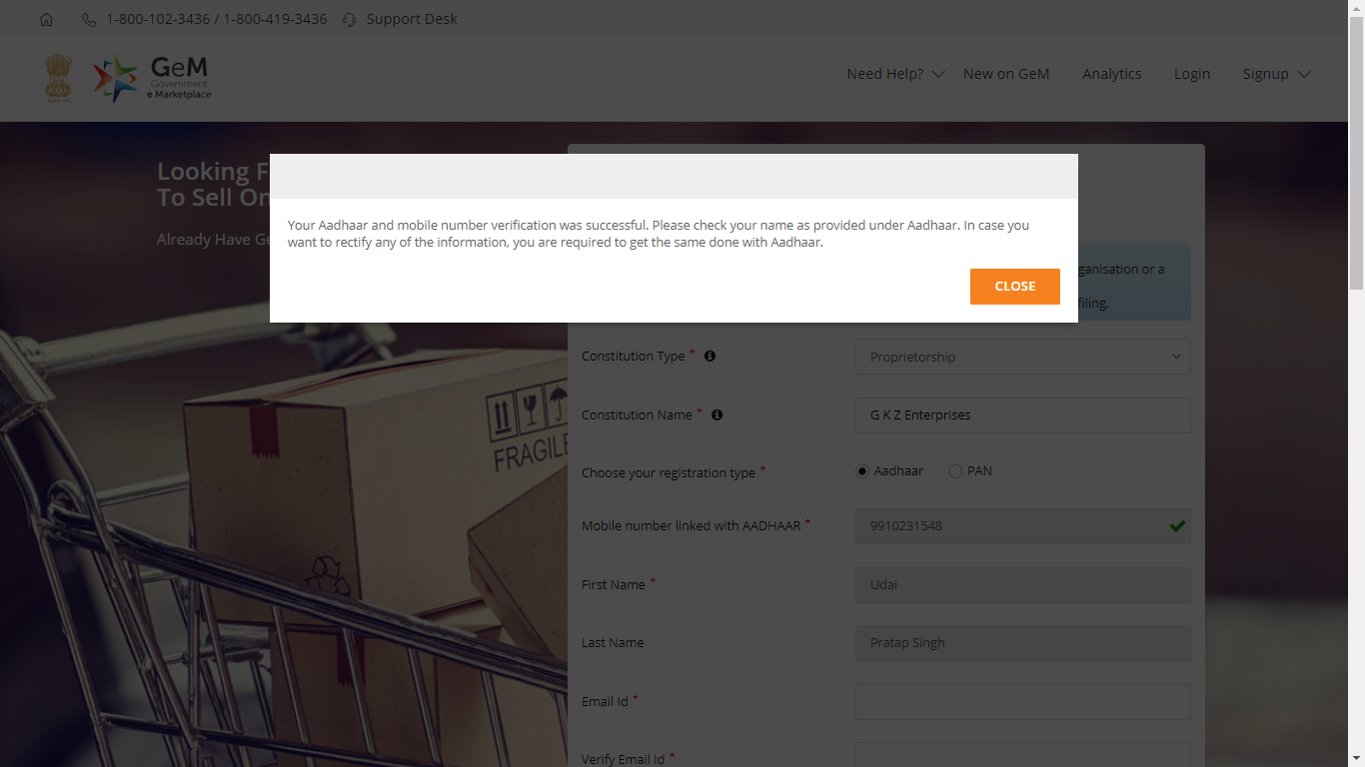
Designed by GeM Training Team

Slide 14
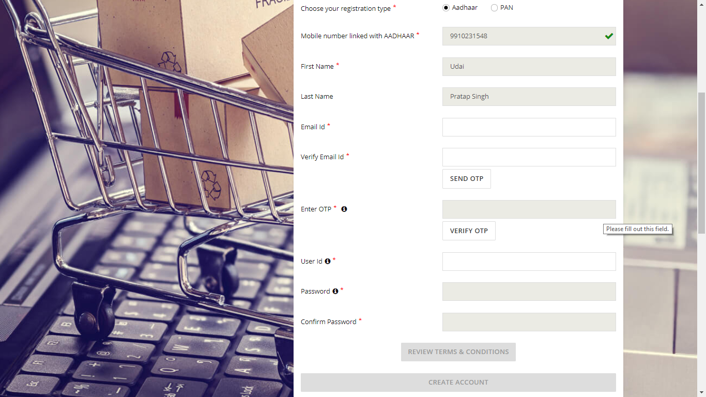

Slide 16
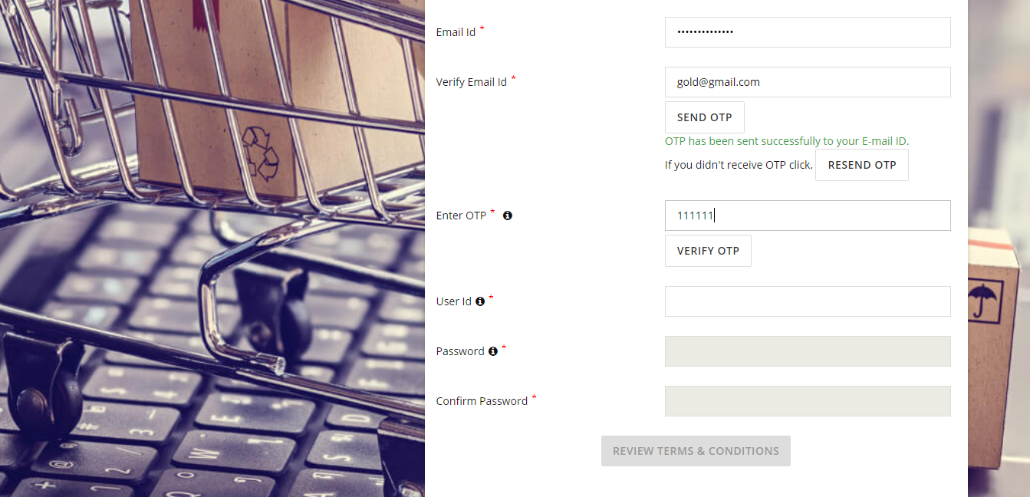

Slide 17
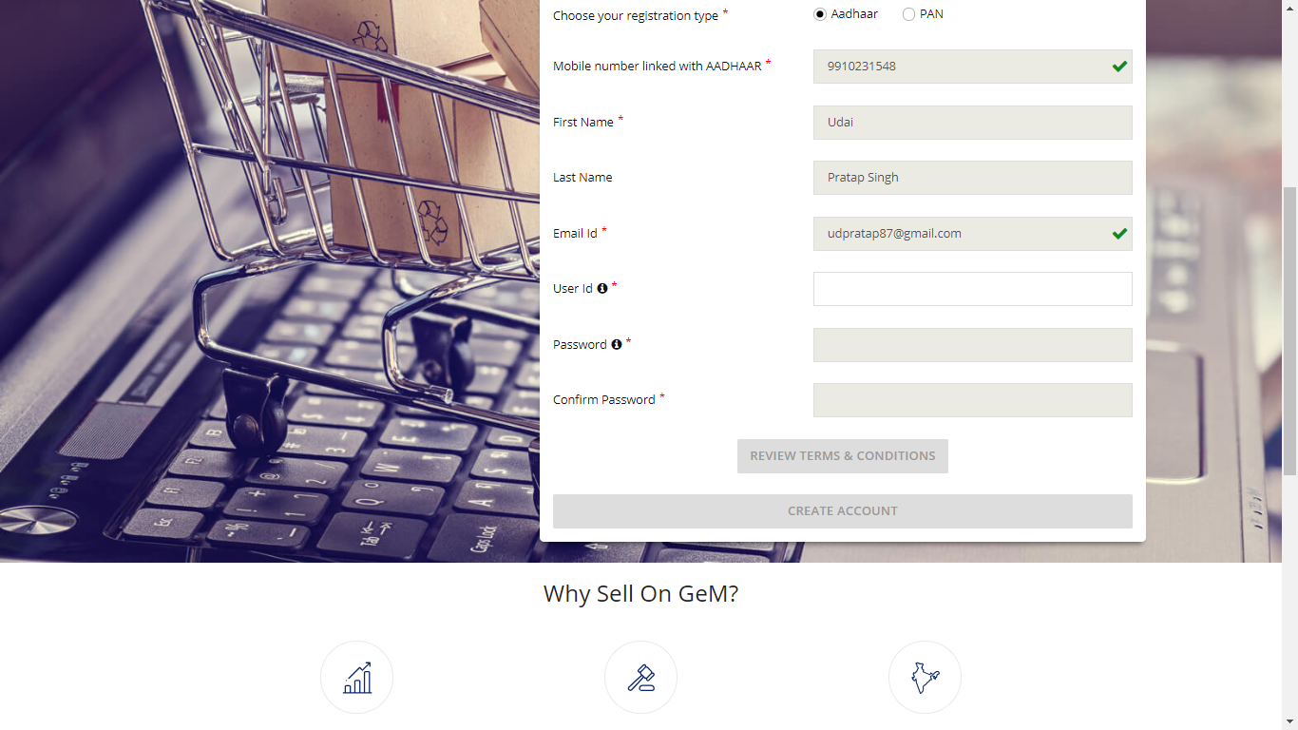
Advisory: Create user id according to your designation or organization, once created, user id cannot be edited
Password must contain minimum of 8 characters - Upper case, lower case, numbers ,special character (For e.g. – Abc@12345)

Slide 18
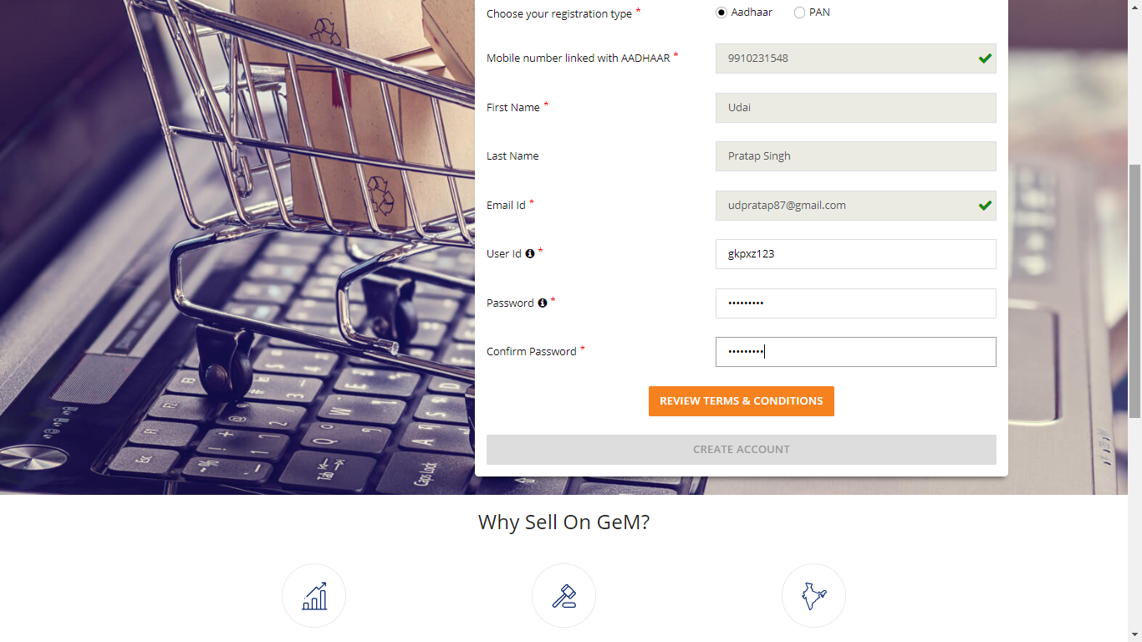

Slide 19
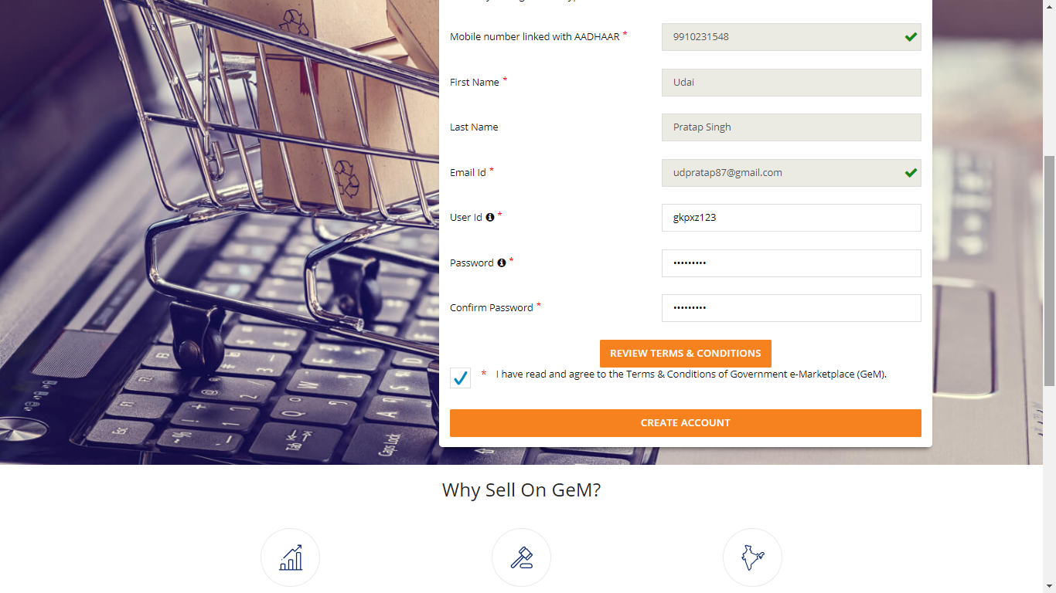

Slide 20
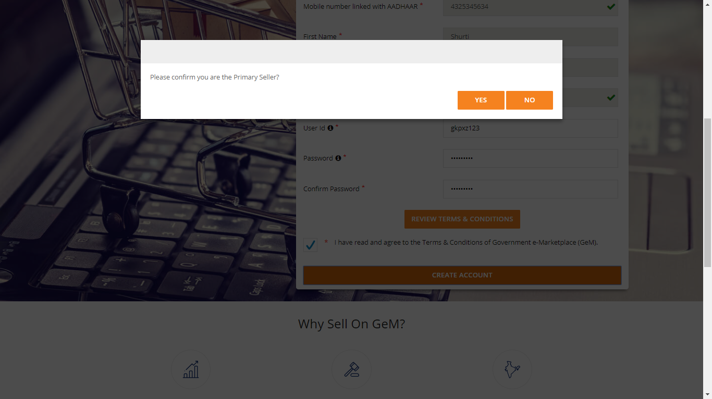
Designed by GeM Training Team

Slide 22
Designed by GeM Training Team

